Slide 1
Salary and compensation through analysis excel data modeling
STUDENT NAME: Rithvika J
REGISTER NO: 312217038
DEPARTMENT: lll B.com., general
COLLEGE : Shri Krishnaswamy college for women

Slide 2
PROJECT TITLE
SALARY AND COMPENSATION THROUGH ANALYSIS EXCEL DATA MODELING

Slide 3


AGENDA
Problem Statement
Project Overview
End Users
Our Solution and Proposition
Dataset Description
Modelling Approach
Results and Discussion
Conclusion
3/21/2024 Annual Review

Slide 4

PROBLEM STATEMENT
To analyze salary and compensation data to gain insights into compensation structures, identify trends, and make recommendations for optimizing pay practices.
This involves using Excel for data modeling, visualization, and analysis.
The project aims to analyze salary and compensation data using Excel to uncover insights into compensation practices, identify disparities, and develop strategies for optimizing pay structures
The goal is to leverage data modeling and analysis to support data-driven decisions for fair and competitive compensation
Collecting and preparing salary and compensation data. Applying Excel’s data analysis and modeling tools to explore and interpret the data.

Slide 5

PROJECT OVERVIEW
The project aims to provide a comprehensive analysis of salary and compensation data to help organizations make informed decisions regarding compensation strategies.
This includes identifying disparities, forecasting salary trends, and evaluating the impact of compensation on employee retention and satisfaction.
The analysis will cover various dimensions of compensation, including base salary, bonuses, benefits, and other forms of remuneration.
The project will involve data cleaning, exploratory data analysis (EDA), modeling, and the creation of visual reports.
Generate visual reports and dashboards to present findings and recommendations.

Slide 6

WHO ARE THE END USERS?
Human Resources (HR) Professionals: To design and implement fair and competitive compensation packages.
Finance Managers: For budgeting and financial planning related to employee compensation.
Executives: To make strategic decisions regarding compensation policies and practices.
Employees: As the ultimate recipients of compensation packages, their feedback may be used to refine and improve compensation structures.

Slide 7

OUR SOLUTION AND ITS VALUE PROPOSITION
Solution: Develop an Excel-based analytical tool that provides interactive dashboards and reports to analyze and visualize salary and compensation data. This tool will facilitate:
Benchmarking compensation against industry standards.
Identifying pay disparities and trends.
Forecasting future compensation needs based on various scenarios.
Evaluating the effectiveness of current compensation strategies.
Proposition: By leveraging Excel’s advanced data analysis and visualization capabilities, our solution will offer actionable insights and support data-driven decision-making. This will enable organizations to enhance their compensation strategies, improve employee satisfaction, and achieve better alignment with market standards.

Slide 8
Dataset Description
Data Sources: The dataset includes various sources such as internal HR records, industry salary surveys, and compensation reports.
Data Elements: Employee Information: Employee ID, department, role, years of service, and location. Compensation Details: Base salary, bonuses, commissions, benefits, and total compensation. Benchmark Data: Industry standards, regional salary averages, and competitor compensation data. Additional Variables: Performance metrics, job levels, and educational qualifications.

Slide 9

THE "WOW" IN OUR SOLUTION
Interactive Dashboards: Real-time updates and customizable views for users to explore data dynamically.
Advanced Forecasting Models: Predictive analytics to forecast future compensation trends based on different scenarios.
Benchmarking Analysis: Comparative analysis with industry standards and competitors to ensure competitive compensation packages.
Automated Reporting: Streamlined generation of reports and visualizations, reducing manual effort and increasing accuracy.
3/21/2024 Annual Review
9

Slide 10
MODELLING
Data Analysis: Use Excel functions like pivot tables, VLOOKUP, and complex formulas to analyze compensation data.
Statistical Models: Apply regression analysis and forecasting models to understand trends and predict future compensation.
Scenario Analysis: Evaluate the impact of different compensation scenarios on overall budget and employee satisfaction.
10

Slide 11
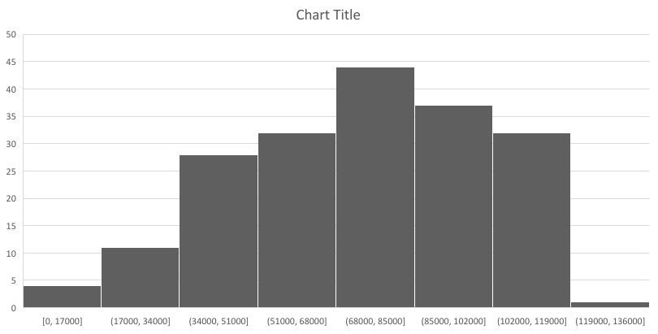
RESULTS
11

Slide 12
conclusion
The project successfully utilized Excel data modeling to provide a detailed analysis of salary and compensation data.
The insights gained have enabled the organization to identify compensation disparities, forecast future trends, and benchmark against industry standards.
The interactive dashboards and advanced forecasting models offer valuable tools for making informed decisions and optimizing compensation strategies.
This data-driven approach supports fair, competitive, and strategic compensation practices that align with organizational goals and industry benchmarks.

